Slide 1




A mail merge document is designed to be sent to many people. The document consists of two components:
Master Document
Source file containing the data (Spreadsheet or Database)
Data from the source file (names and addresses) is combined with the Master document so that key fields do not need to be typed one by one.
This will save time and reduce the chance of errors in the document.
Source Data
Master Document

Slide 2
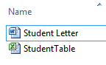
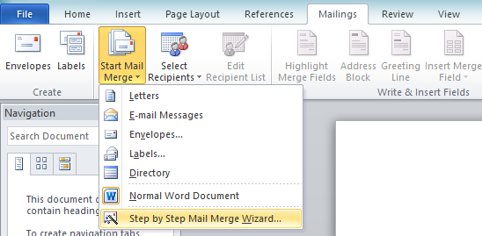
For a mail merge you need a master Word Document
Data Source : Which will contain the recipient data
Excel (Workbook/CSV)
Access (Table/Query)
Task 1
Open the Master Document
Click Mailings
>> Start Mail Merge >> Step by Step Mail Merge Wizard

Slide 3
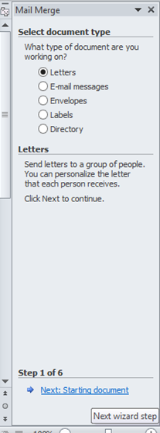
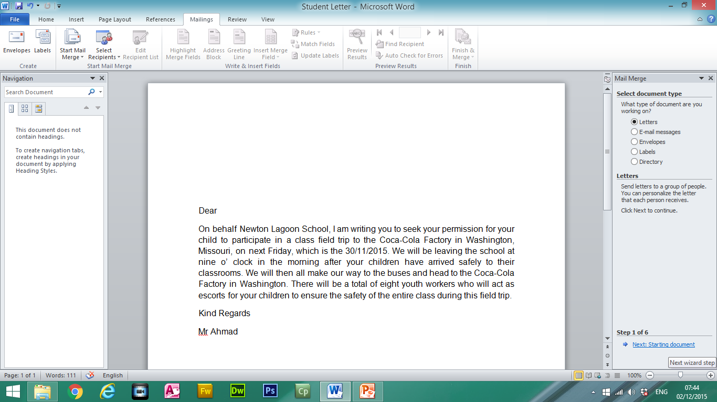
Task 2:
The mail merge wizard will start.
Click on Next.

Slide 4
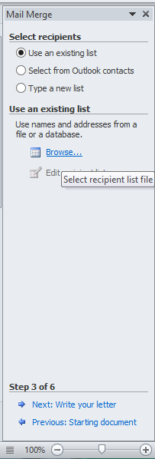
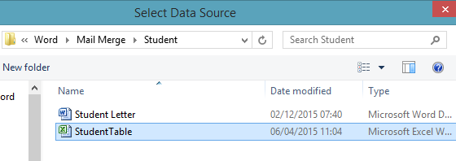
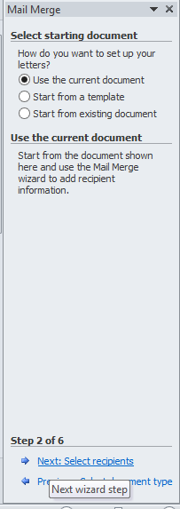
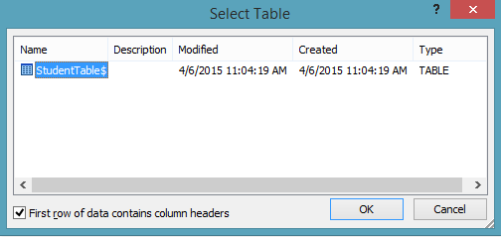
Task 3:
Use the current document and click next
Browse and select the recipient data source

Slide 5
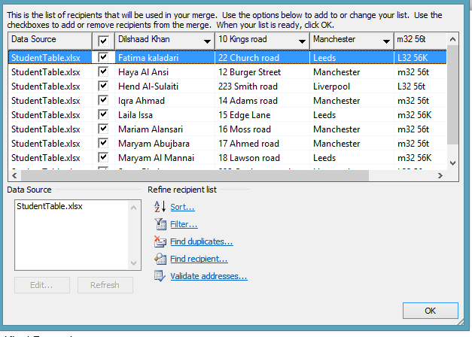

Task 4:
The recipient data source is shown.
Double check if the data source is correct before clicking on Ok.
If a record is not required then you can untick the option.

Slide 6
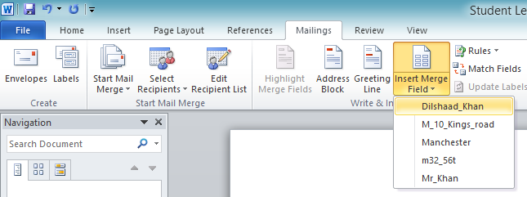
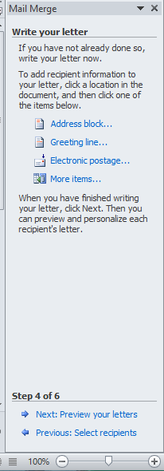
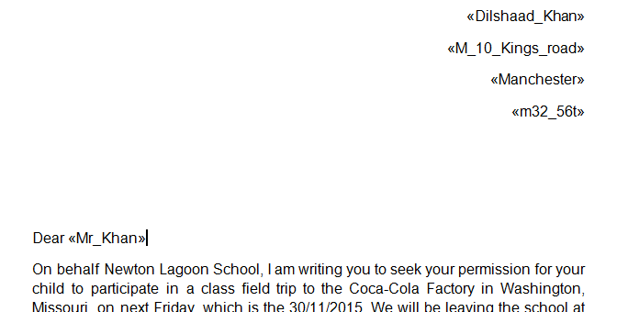
Task 5:
Click on Next to Write your letter
Then Insert the Merged Fields in the appropriate place
Fields will show as:
<<field>>
This is know as the master document. You may have to evidence this.

Slide 7
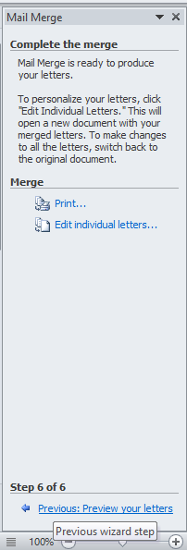

Task 6:
You can then preview all of the merged letters by clicking on the backward or forward buttons at the top of the page.

Slide 8
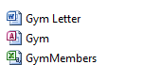
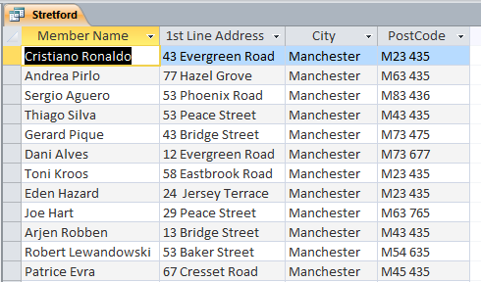
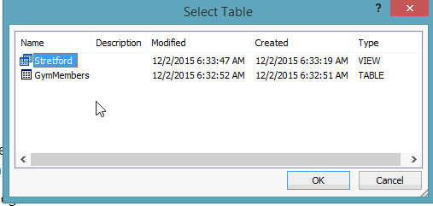
Linking to a Database Query
Sometimes you may have filter (query) data from a data source.
Import CSV into a database application and run the required query.
Save the query
Merge the query to your master document

